Slide 1
Equity in Resilience Building for Climate Smart Disaster Risk Reduction
SUNSHINE AFTER THE STORM

Slide 2
Equity Issues Human and Civil Rights Framework
HUMAN RIGHTS
Right to Self Determination
Right to Safe and Healthy Work Conditions
Right to Highest Standard of Physical and Mental Health
Right to Food
Right to a Decent Living Condition
Equal Rights Between Men and Women
Right of Youth and Children to be Free From Exploitation
CIVIL RIGHTS
Ensuring peoples' physical integrity and safety.
Protection from discrimination on grounds such as gender, religion, race, sexual orientation, national origin, age, immigrant status, etc.
Equal access to health care, education, culture, etc.

Slide 3
Setting the Context

Slide 4
“Disasters, however ‘natural,’ are profoundly discriminatory. Pre-existing structures and social conditions determine how a community will be affected
and who will pay the highest price.”
~~ Oxfam Report, “Exposed: Social Vulnerability and Climate Change

Slide 5
Climate Change

Slide 8
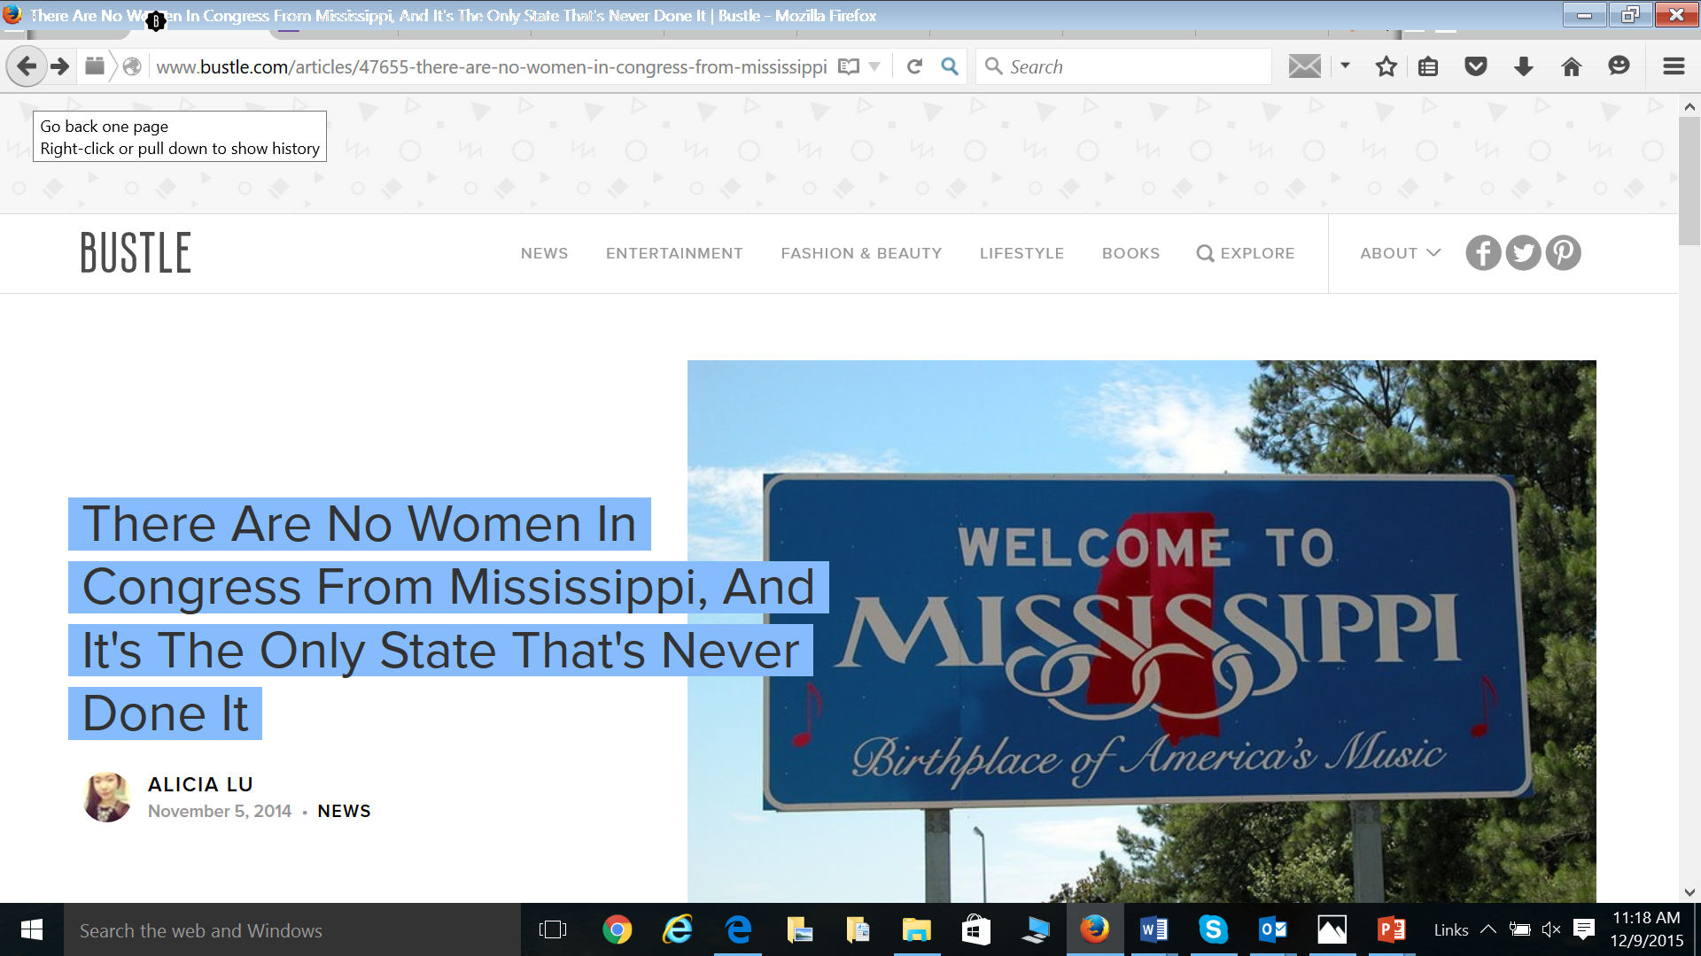

Slide 9
Increase in Extreme Weather

Slide 10
Tornadoes
Notes:
With are changing climate, we are seeing an increase in the frequency and severity
Of extreme weather events. While tornados, scientifically, cannot be attributed to a warming world,
When they do happen, being ill-prepared or not having resources in place can impact communities differently.

Slide 11
Flooding

Slide 12
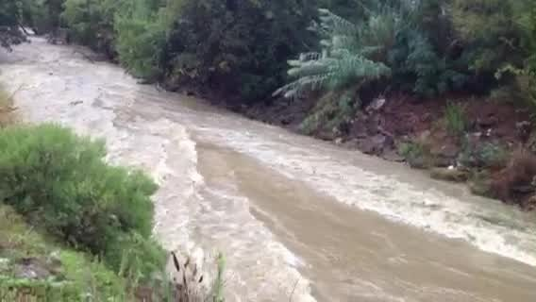

Slide 13
Sea Level Rise

Slide 15
Today’s “Flood”=Tomorrow’s “High Tide”

Slide 16
VULNERABILITIES/ASSETS
Demographics
Housing Security
Food Security
Mobility
Health Status/Systems/Services
Environmental Hazards
Emergency Services

Slide 17
Differentially Impacted Groups
Non-Dominant Culture
Immigration Status
Differently Abled
Elderly persons
Women/pregnant women
Children
Prisoners/formerly incarcerated persons
Economically disadvantaged persons
People of color
Undocumented workers
People with language barriers

Slide 18
Areas of Vulnerability
Economic-Political Power
Community Infrastructure
Economic Status
Under Insurance
Poor Housing Stock
Flood Plain
Pre-Existing Health Conditions

Slide 19
Preparation

Slide 20
Flood Plain

Slide 21
Housing Stock

Slide 22
Housing Stock
Notes:
Which is so evident here….when things happen and we are not prepared, from a community perspective, we can be impacted differently.

Slide 23
Pre-Existing Health Conditions

Slide 24
Aging
During emergencies and in their aftermaths, the health of older adults can deteriorate because of poor nutrition, extreme temperatures, exposure to infection, interruptions in medical treatment, and emotional distress.

Slide 25
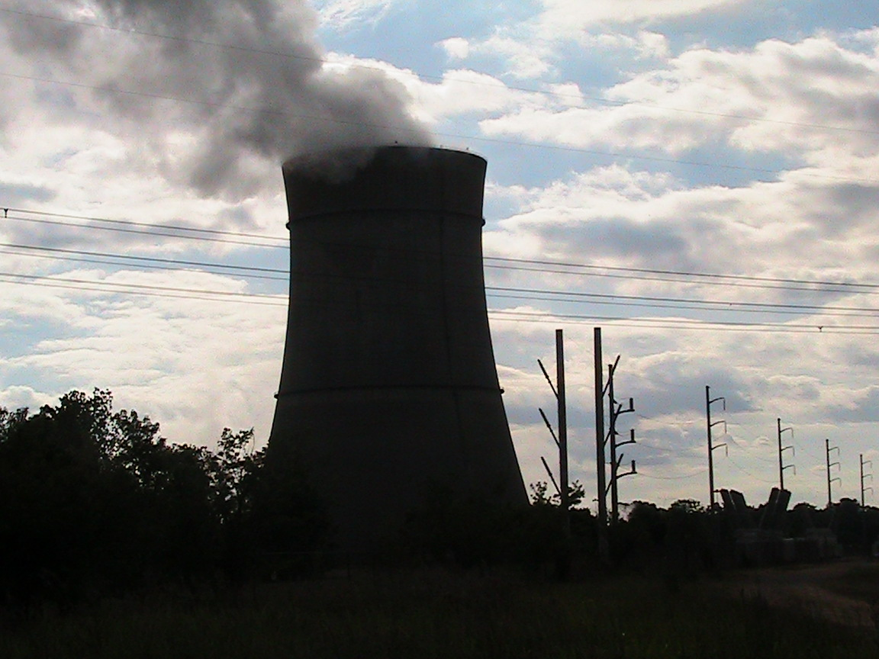
Risk Compounded By Toxic Exposure

Slide 26
Prisoners’ Rights

Slide 27
Gendered Impacts
Women disproportionately poor and thus already predisposed to insecurity and displacement
Health impacts—and shift in family roles
Violence Against Women
Diversity in Sexual Identities—Issues with sheltering

Slide 28
Race Relations---Madison Family Home Site

Slide 29
Disaster Relief and Recovery

Slide 30
Post Disaster Equity Framework
Procedural equity encompasses fairness in political processes and participation in decision making.
Distributive equity highlights the need to consider not just the allocation of benefits, but also the costs and risks with a focus on the outcomes of allocation decisions.
Contextual equity recognizes the fact that the playing field is never level but that people’s capabilities and their access to resources and power determine the extent to which they are able to utilize procedural equity to determine the best distributive outcome for themselves.

Slide 31
Bases for Inequitable Practices
Differential Valuation of People (tied to societal underpinnings)
Political Disenfranchisement
Knowledge Deficits
Lack of representation in planning/decision making
Utilitarianism

Slide 32
Criminalization

Slide 33
During Hurricane Katrina, over 1,800 individuals died because they were unable to evacuate the city.
Persons with special health conditions and persons who were elderly, poor, or differently abled were the most likely to die.
Low-income African Americans often could not evacuate because they had no personal transportation.

Slide 34
Who is able to respond?

Slide 35
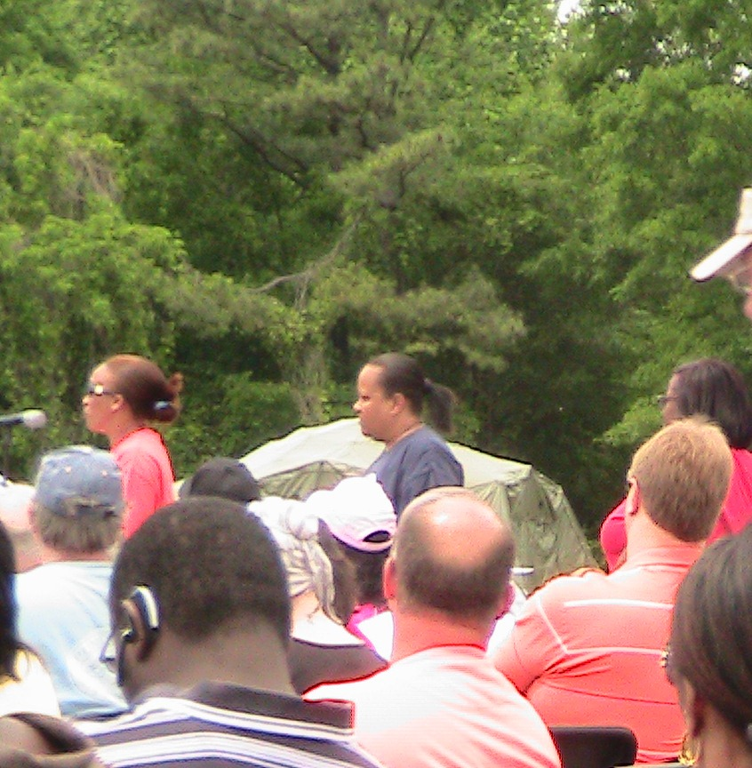
Who’s Making the Decisions?

Slide 36
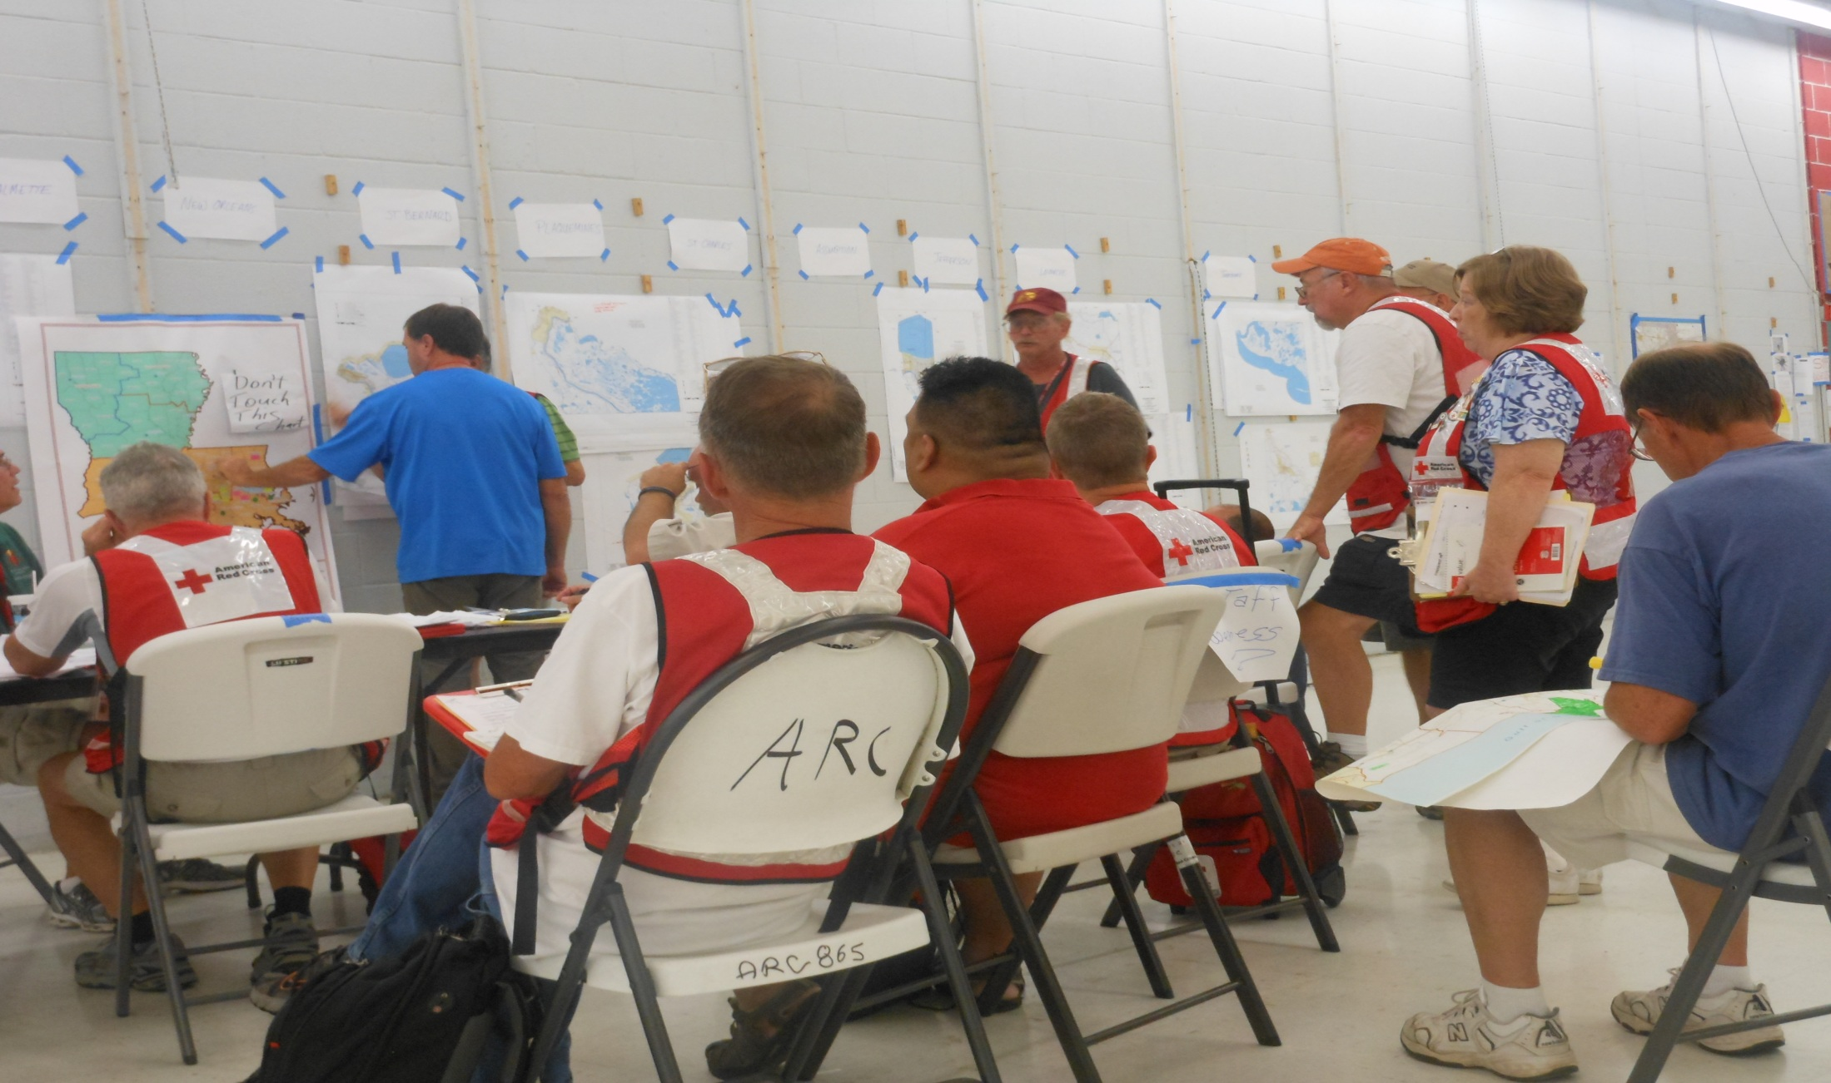
Who Is Delivering Assistance?

Slide 37
Undocumented Workers
In the aftermath of Hurricane Katrina, thousands of workers, many of whom were undocumented, moved to New Orleans.
Employers often housed individuals in deplorable conditions, required them to do extremely hazardous work, and denied them the pay they were promised.
Workers, faced significant health risks and were not provided appropriate training or protective gear.

Slide 39
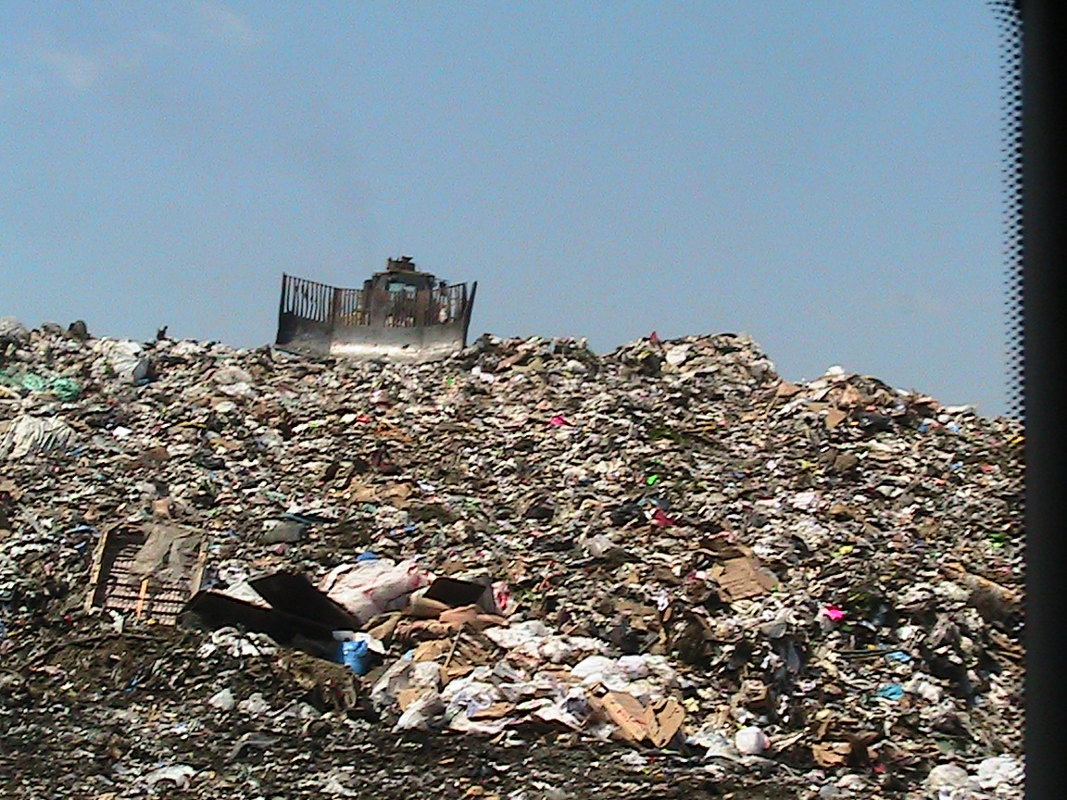
Notes:
n 2009, Wichita generated almost 4.8 pounds of trash per person per day. This is above the national average of 4.3 pounds.

Slide 40
Waste Being Dumped in Our Communities
Notes:
Every community that received waste from the BP oil spill had a POC population that was higher than the national average. The one white county that was going to receive the waste put up such a protest that they ended up not sending the waste there.

Slide 41
Ability to Recover

Slide 42
Employment Security

Slide 43
Right to Return?

Slide 44
Women Leading on Climate Smart Disaster Resilient Communities

Slide 45
VOTING RIGHTS

Slide 46
41 Million Strong Campaign

Slide 47
Engaging Educational/Research Institutions
Policy
Strengthened laws that combat the underlying vulnerabilities
Process
Better and more participatory systems
Implementation
Leverage willingness for collaboration to strengthen community resilience that leads to new partnerships and new ways of operating
Notes:
Disasters present opportunities to think differently and more creatively about the policies, processes, and implementation strategies that ensure equitable recovery.
Build off of lessons learned
Utilize effective models and redeploy them

Slide 48
Engaging Women and Girls in STEM

Slide 49
Educating Ourselves

Slide 50
Increasing Community Engagement in Climate Adaptation Planning

Slide 51
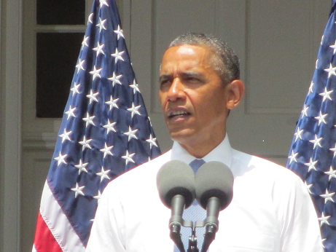
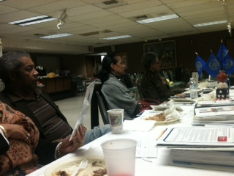
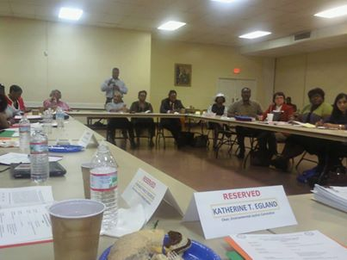
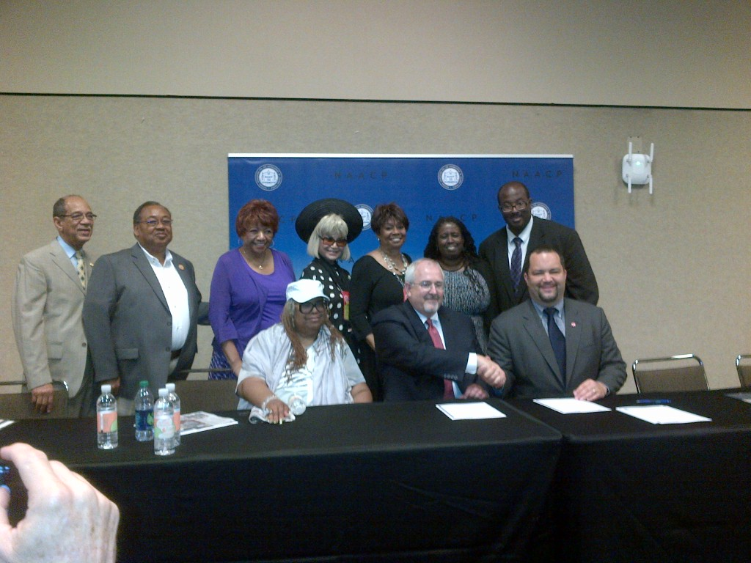
Engaging with Government/Policy
Justice in Emergency Management
--------------------------------------------------
Launching Eco-Districts in
Gulfport, MS ; Prichard, AL; Longview, TX
---------------------------------------------------------------------------
NAACP Emergency Management Plan Drafted
Regional and State Relationships with FEMA Established
Eco District Visioning/Planning Sessions Completed –Community Gardens, Zero Waste, Green School Projects Initiated
NAACP Advisory Role on 6 planning teams and over 30 presentations

Slide 52
Being at the Table for Policymaking

Slide 53
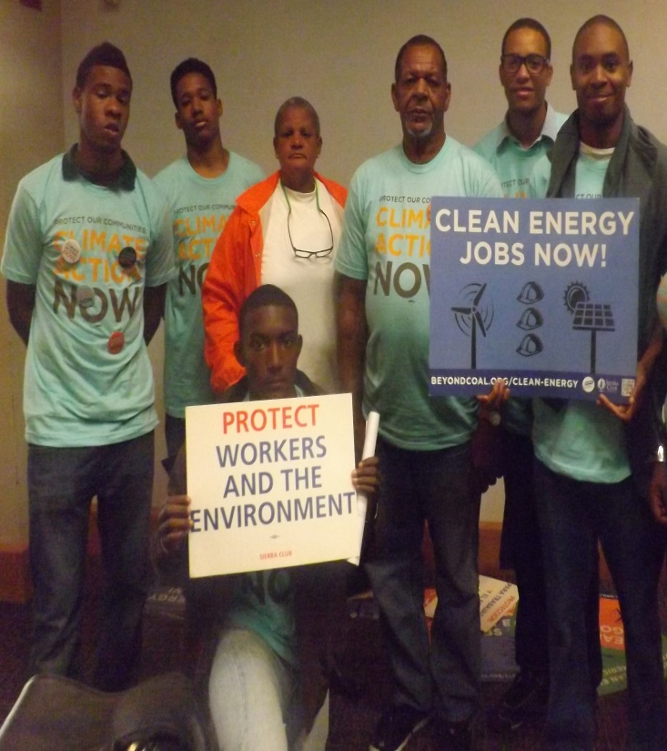
GULFPORT VICTORY
Gulfport NAACP Instrumental in Jack Watson Coal Plant Cessation of Coal Burning

Slide 54
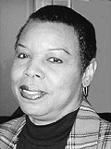

Slide 55
Increasing Economic Opportunity—Jobs and Small Business Development

Slide 58
OUTCOMES
Life and health
Safety and wellbeing
Community and culture
Land, home, and property
Livelihoods and economic security
Core systems, services, and basic needs
Environmental quality
Democratic systems of governance.

Slide 59
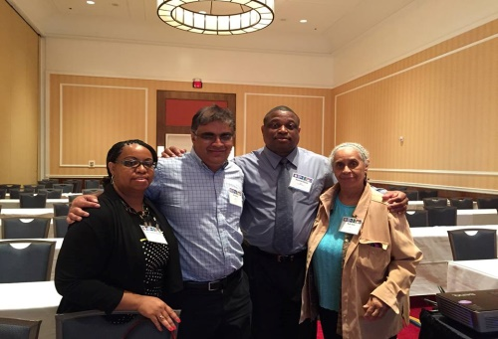
Telling the Story
Gulfport at People’s Climate March
& National Adaptation Forum

Slide 60
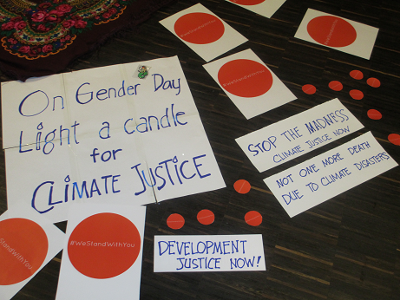
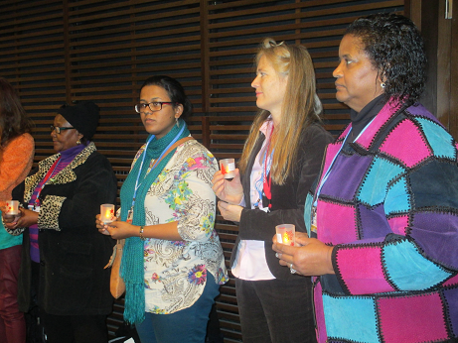

Slide 61
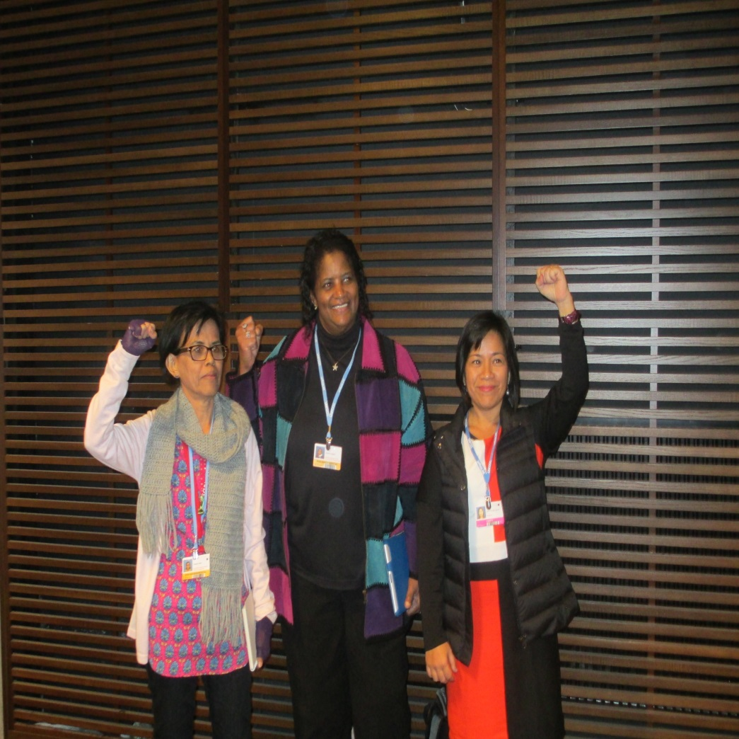
Three Sisters United
Sheila Holt Orsted
Katherine Egland
NeAnna Roane McLean

Slide 62
Thank You
Jacqui Patterson
Director, Environmental and Climate Justice
jpatterson@naacpnet.org
443-465-9809

